Slide 1



Advanced Short Circuit Preventive Mechanism for Electric Vehicles
Submitted by
SHANJAY R K | (927621BEC195)
SIVARAMAKRISHNAN M | (927621BEC201)
SUBASH P | (927621BEC213)
YASAR S | (927621BEC245)
Guided By
Dr.K.Sheikdavood (AP/ECE)

Slide 2
Objective
By creating a cutting-edge short circuit prevention system, our initiative seeks to transform electrical safety in electric vehicles. The system improves safety and guarantees proactive risk reduction by utilising self-healing technology, AI-based predictive analytics, and real-time monitoring. With an emphasis on system dependability, energy efficiency, and scalability, this solution is made to safeguard vital parts, minimise downtime, and easily adjust to new developments in technology, establishing a new benchmark for safe and sustainable electric vehicle operations.

Slide 3
Literature Review Table
Author | Title | Year of published | Drawback
D. Qiao et al | "Quantitative Diagnosis of Internal Short Circuit for Lithium-Ion Batteries Using Relaxation Voltage" | 2024, IEEE Transactions on Industrial Electronics | Focuses primarily on diagnosis without providing real-time mitigation strategies for detected faults.
Z. Sun et al. | "An Online Data-Driven Fault Diagnosis and Thermal Runaway Early Warning for Electric Vehicle Batteries" | 2022, IEEE Transactions on Power Electronics | Limited to battery systems; lacks consideration of external factors like environmental conditions.
F. Kaya and O. Akar | "Short Circuit Effects on HV Feeders of Optimally Located Electric Vehicle Fast Charging Stations" | 2024, IEEE Access | Addresses stationary systems only; does not factor in dynamic or mobile EV charging scenarios.

Slide 4
Existing System
Fuse Protection
Current Limiting Device
Electronic Safety Relays
Ground Fault Detection

Slide 5
Proposed Methodology
Cell Imbalancing detection
AI-Based Predictive Analytics
Automated Circuit Isolation Mechanism
Real-time Voltage and Current Monitoring

Slide 6
Plan for Implementation
Collect real-time data such as current, voltage, temperature, and cell imbalance using onboard sensors.
Extract meaningful features like voltage deviation, temperature rise rate, and current spikes. Normalize data for consistency.
Long Short-Term Memory (LSTM) networks.
When LSTM predicts a risk, a microcontroller instantly activates a relay to isolate the battery and prevent damage.

Slide 7
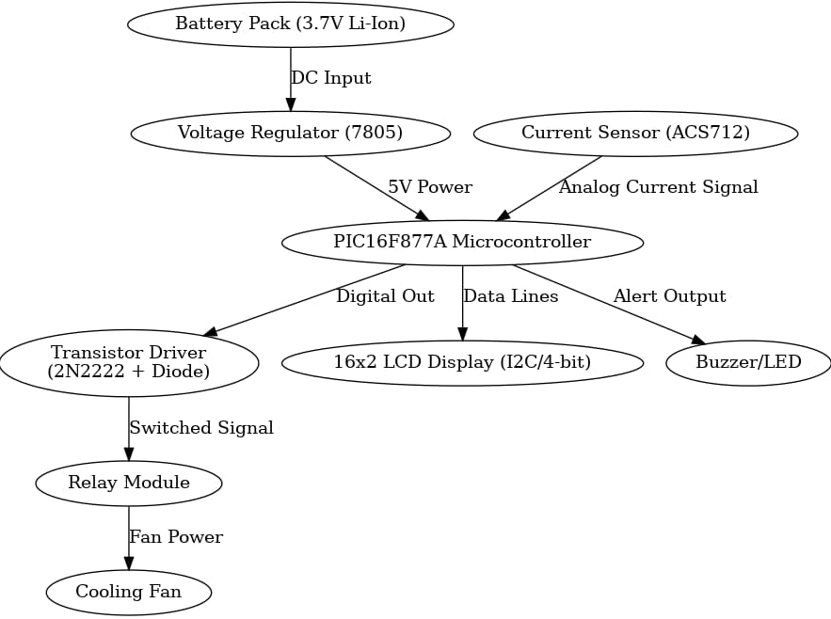
Block Diagram

Slide 8
Working of Proposed System
Sensors monitor real-time voltage, current, temperature, and cell imbalance, sending data to a
PIC microcontroller for local processing.
The data is simultaneously updated to the cloud for remote monitoring and further analysis.
An LSTM-based machine learning model runs on edge/cloud to predict short circuit risks and trigger a
relay-based cut-off if needed.
An efficient cooling system using liquid cooling with phase-change material (PCM) or active
air-cooled fins maintains optimal battery temperature during high-load conditions.

Slide 9
Importance of ML Algorithm
Early Detection of Short Circuits
Pattern-Based Analysis
Adaptive Learning System
Enhanced Battery Safety

Slide 10
Components Used
PIC16F877A PIC Microcontroller
ESP8266 Wi-Fi Module
Current Sensors (ACS712)
Cell Voltage Monitor (ADS1115)
Temperature Sensor(DS18B20)
Two cylindrical Li-ion cells
LED Indicators
Relay Module
Active Cooling System

Slide 11
Expected Results
Automated Circuit Isolation
Systematic Component Disconnection
Fault Prediction by continuously Monitoring the electrical Parameters
Real-time Alert

Slide 12
Advantages
Real-time detection allows quicker response to short circuits, minimizing damage.
AI-based predictive analytics enhance maintenance scheduling, reducing downtime.
Automated circuit isolation ensures rapid protection
System recovery without manual intervention.

Slide 13
Applications
Electric Vehicle Safety Systems
Autonomous & Connected Vehicles
Battery Energy Storage Systems (BESS)
Smart Grids & Power Distribution

Slide 14
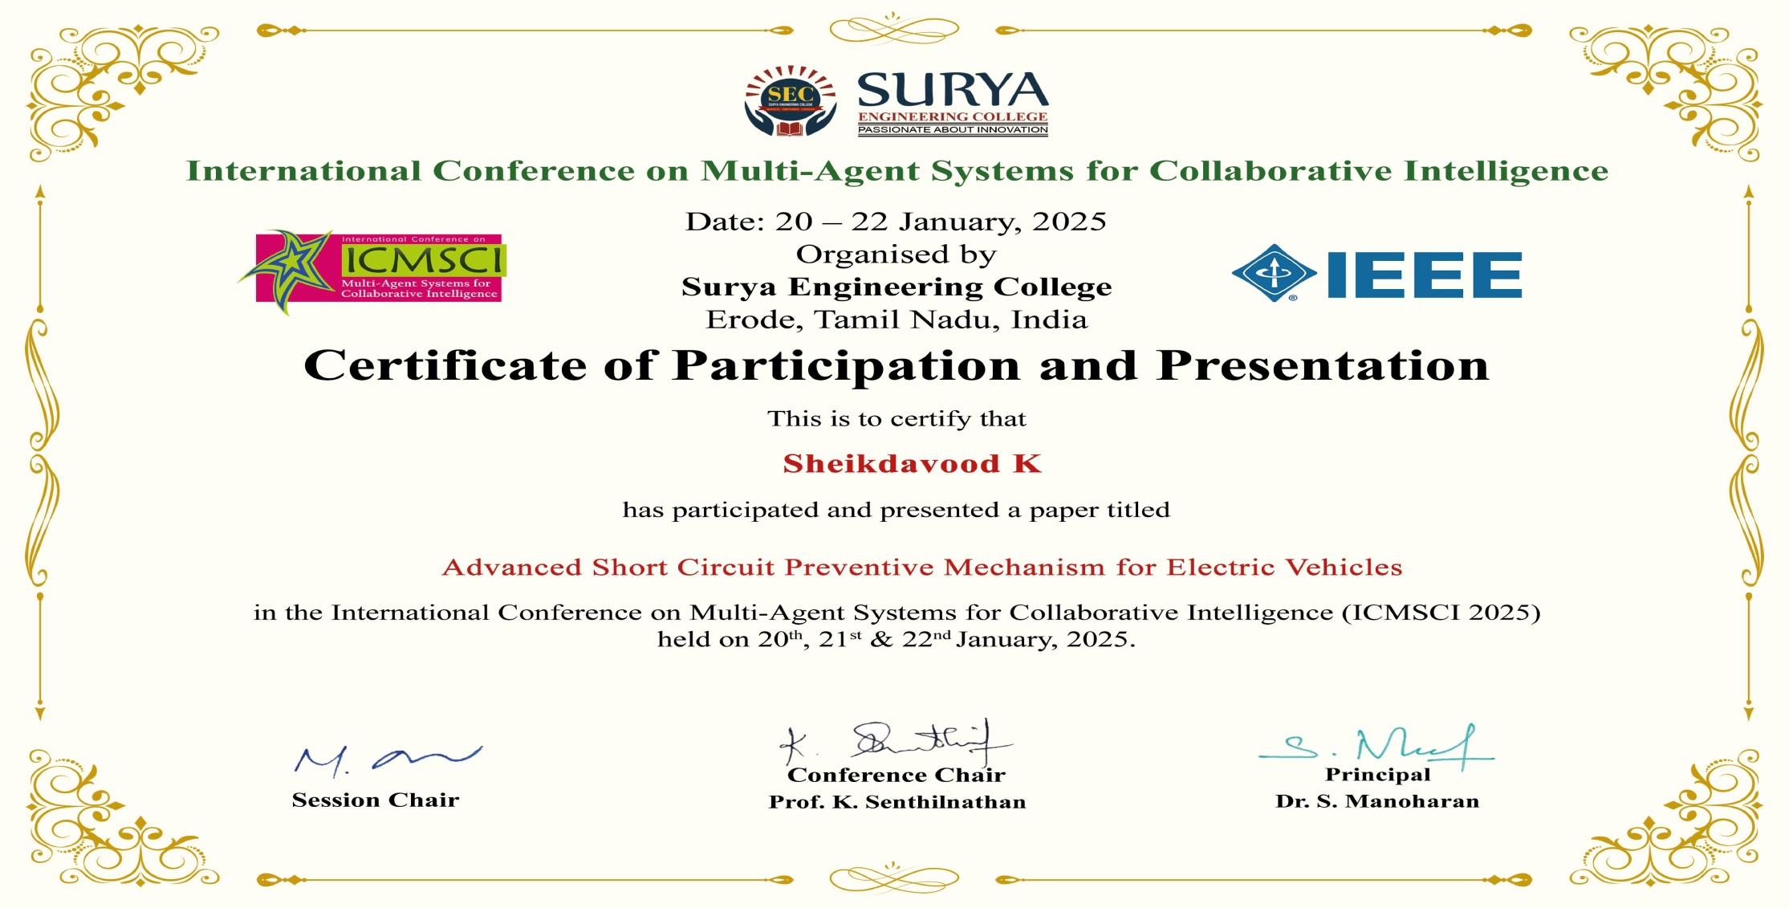
Project Outcome Status as on date Detail(Proof)
.

Slide 15

.
.

Slide 16

.
.

Slide 17

.
.

Slide 18

.
.

Slide 19
Reference
[1] D. Qiao et al., "Quantitative Diagnosis of Internal Short Circuit for Lithium-Ion Batteries Using Relaxation Voltage," in IEEE Transactions on Industrial Electronics, vol. 71, no. 10, pp. 13201-13210, Oct. 2024,doi: 10.1109/TIE.2023.3342289.
[2] D. Walch, A. Geiger and C. Sültrop, "Inter-Turn Short Circuit Faults and Mitigation Measures for Dual-Three Phase Machines," 2024 International Conference on Electrical Machines (ICEM), Torino, Italy, 2024, pp. 1-7, doi: 10.1109/ICEM60801.2024.10700240.
[3] I. Husain et al., "Electric Drive Technology Trends, Challenges, and Opportunities for Future Electric Vehicles," in Proceedings of the IEEE, vol. 109, no. 6, pp. 1039-1059, June 2021,doi: 10.1109/JPROC.2020.3046112.
[4] A. Jose, A. M. Varghese, F. E. Jenson, P. Jacob, D. M. Anumod and D. Thomas, "Solid-State Circuit Breaker based Smart Distribution Board with IoT Integration," 2020 Third International Conference on Smart Systems and Inventive Technology (ICSSIT), Tirunelveli, India, 2020, pp. 54-61, doi: 10.1109/ICSSIT48917.2020.9214172.

